Slide 1


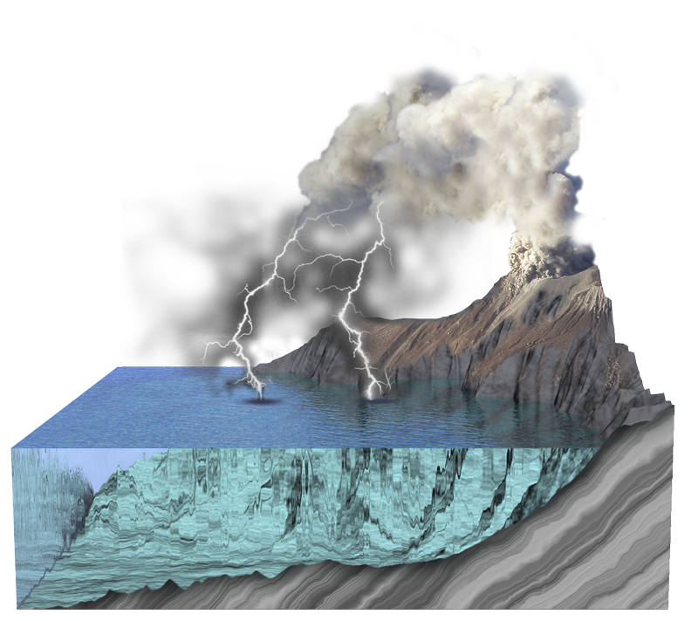
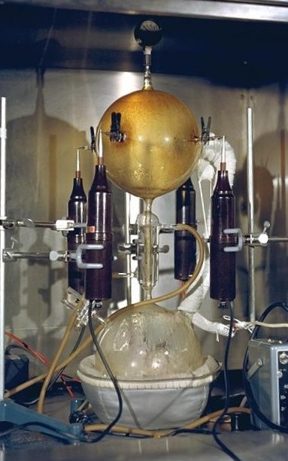

Evolution Series: Set 2
Copyright © 2005
Version: 2.0

Slide 2
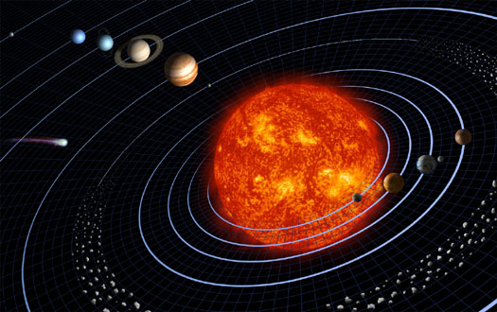
Formation of a Solar
System
More than 4 billion years ago, an interstellar dust cloud collapsed into a swirling accretion disk that gave rise to the sun and planets of our solar system (left).
Some of the fragile molecules survived the heat of solar system formation by forming comets at the disk’s fringe where temperatures were freezing.
The comets and other remnants carried the molecules to Earth.
Photo: NASA

Slide 3
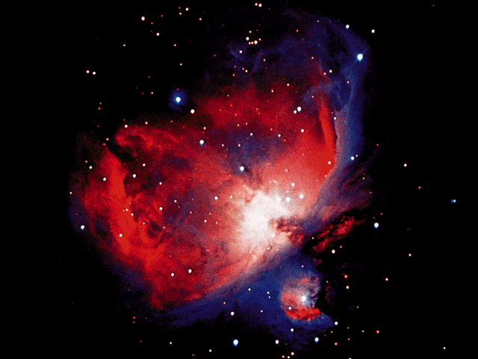
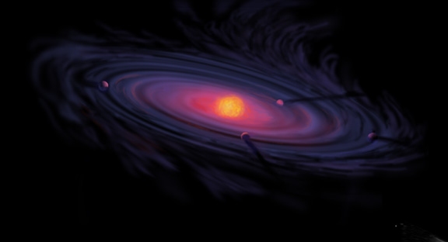
Solar System Formation
Interstellar dust and gas
Nebula
The nebula model proposes that the sun and planets formed from a flattened cloud of interstellar material (pre-solar nebula).
As the nebula collapsed, it began to rotate and flatten along its rotational axis.
The center became hotter than the outside, and eventually formed the Sun.
Gases and dust condensed and combined to form the planets and moons in a process termed accretion (or planet formation).
Similar processes in the Orion nebula are observed today by the Hubble telescope, lending weight to this theory.
Photo: NASA
Accretion disc
Sun
Artists impression: NASA
Planets forming

Slide 4
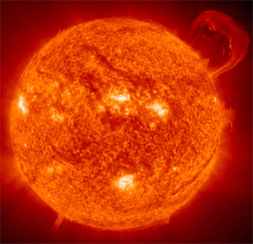
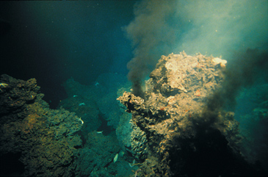


Life As We Know It
Life ‘as we know it’ requires three basic ingredients. These are:
  a source of energy
    the sun (top right) for photosynthetic organisms.
    thermal vents (bottom right) for chemosynthetic organisms.
  a carbon source.
  liquid water (e.g. geysers).
Photos: NASA
Complex organic molecules (the basis of living things) have been detected beyond Earth in interstellar dust clouds and in meteorites.

Slide 5
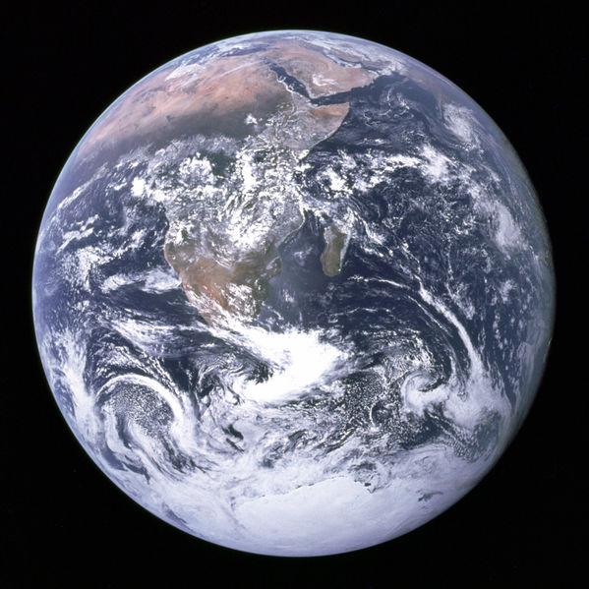
Origin of Life Scenarios
The origin of life on Earth remains a matter of scientific speculation. The alternative views of how life may have originated include:
  The ocean surface theory
  The panspermia theory, where life on Earth resulted from an extraterrestrial source.
  The ocean thermal vent theory, where life originated deep underwater in a hydrothermal environment.
Photos: NASA
How did life develop on Earth?

Slide 6
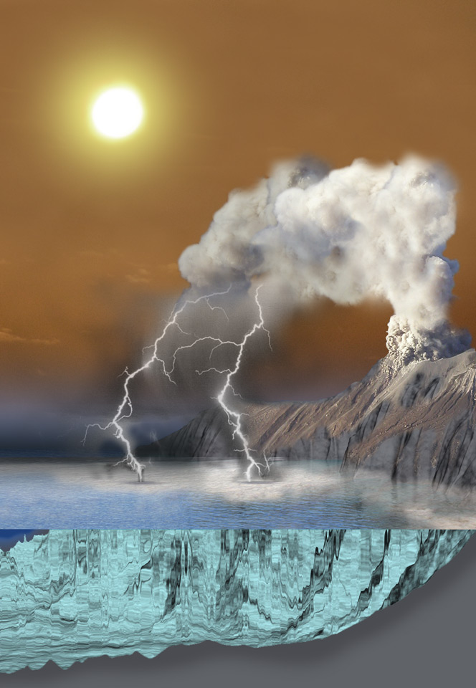
Ocean Surface
Ultraviolet light
Volcanoes provide gases and heat energy
This popular theory proposes that life arose in a small contained water body such as a tidal pool, pond, or on moist clay on primeval Earth.
Gases from volcanoes would have been energized by UV light or electrical discharges to form the prebiotic molecules in froth.
These precursors to life eventually combined to form more complex molecules, resulting in the evolution of simple life-forms.
Lightning
Froth (bubbles)
Prebiotic soup

Slide 7
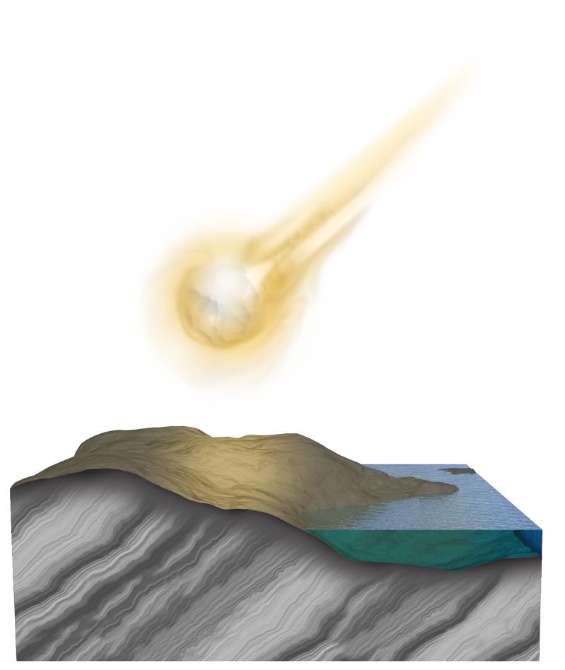
Panspermia
Cosmic ancestry (panspermia) is a serious scientific theory. There are several theories within the concept.
The extreme view of panspermia proposes that living organisms were ‘seeded’ on Earth as ‘passengers’ aboard comets and meteors.
  Such incoming organisms would have had to survive the heat of re-entry.
A more moderate approach proposes that space contains the “building blocks” of life, and life on Earth may have developed from those.
  Aspects of this theory are gaining in popularity as more of life's building blocks are found in space and in space derived material.
Comet or meteorite from elsewhere in the solar system harboring microorganisms

Slide 8
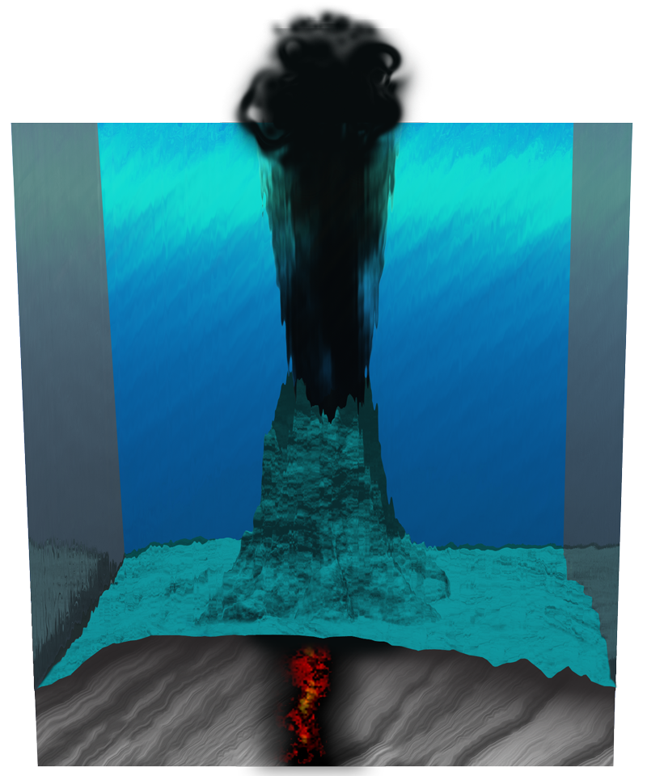
Undersea Thermal Vents
A recently proposed theory suggests that life may have arisen at ancient volcanic vents which provided the necessary gases, energy, and a possible source of catalysts (metal sulfides) for life to develop.
Chemosynthetic bacteria can utilize the chemicals and thermal energy at these vents:
Iron, nickel and copper sulfides may act as catalysts
Carbon monoxide (CO) and hydrogen sulfide (H₂S) gas
Prebiotic molecules are recirculated in the sea water
Deep sea vent
or black smoker
6(CO2) + H2O + 3H2S ➔ C6H12O6 + 3H2SO4
Thriving communities have been found at modern thermal vents, supporting the theory that primitive life could have developed there and supported more complex life forms.

Slide 9

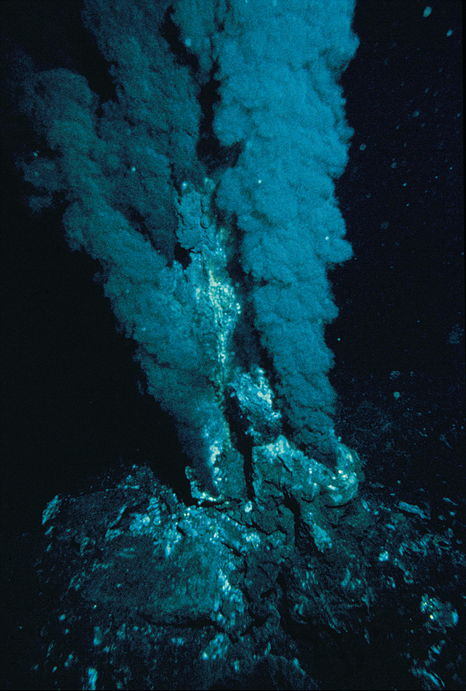
A Black Smoker
In 1977, a vent was discovered at the Galapagos mid-oceanic ridge. It discharged hot water laden with dissolved minerals.
Since this discovery, hydrothermal venting has been found to be common along the length of the
55 000 km ridge crest system.
Black smokers are so named because they gush dirty looking, high temperature (350ºC) water from their chimney structures.
Such an environment is thought to be a possible site for prebiotic synthesis of life’s molecules.

Slide 10
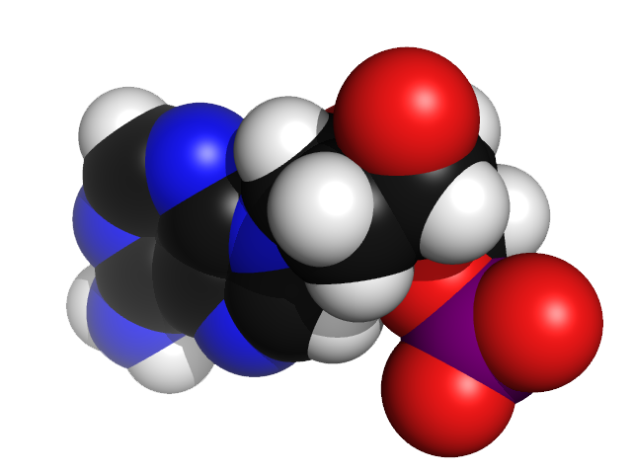
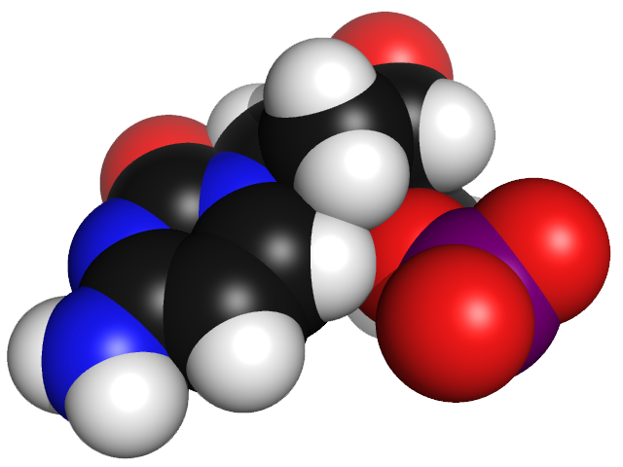
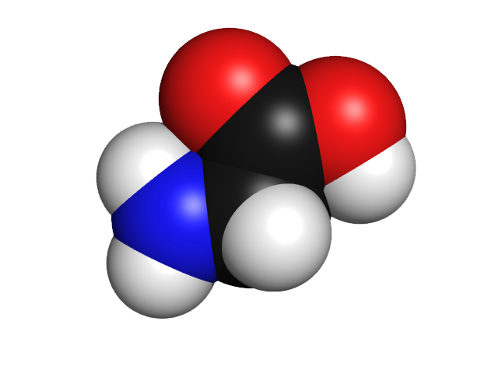
The Origin of Life on Earth
Recent discoveries of prebiotic (before life) conditions on other planets and their moons has rekindled interest in the origin of life on primeval Earth.
Experiments demonstrate that both amino acids and nucleic acids may form polymers naturally in the conditions that are thought to have existed in a primitive terrestrial environment.
RNA has also been shown to have enzymatic properties (ribozymes) and is capable of self-replication.
These discoveries have removed some fundamental obstacles to creating a plausible scientific model for the origin of life from a prebiotic soup.
Adenine
Cytosine
Adenine and cytosine are examples of nucleic acids which may have existed on primeval Earth and formed the early basis of life.
The amino acid glycine (above) has been found in interstellar space and in meteorites that have landed on Earth. This discovery gives new weight to the theory that the chemistry that created life on Earth may occur elsewhere in space.

Slide 11
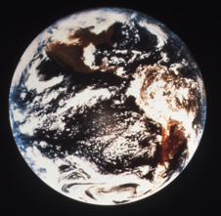
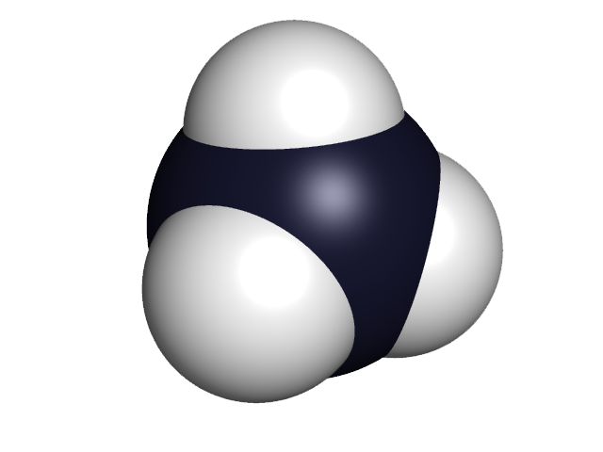
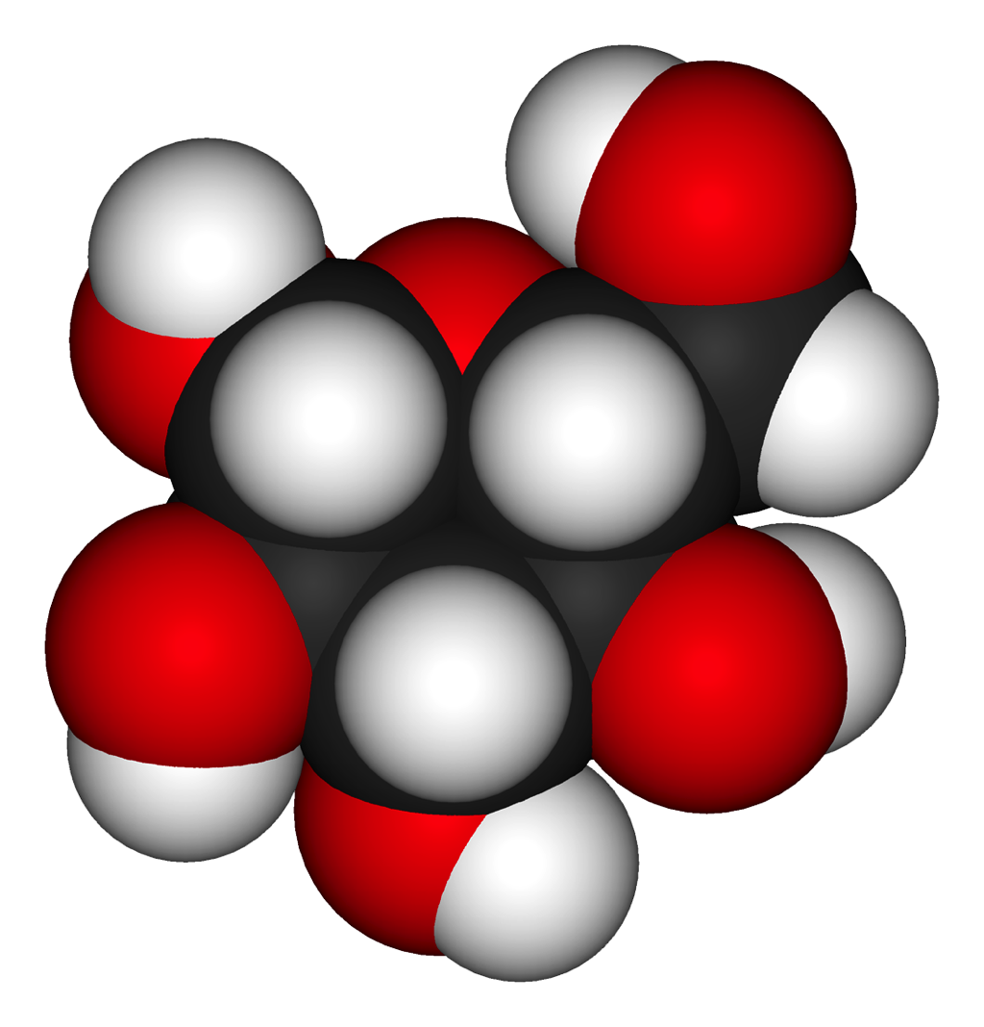
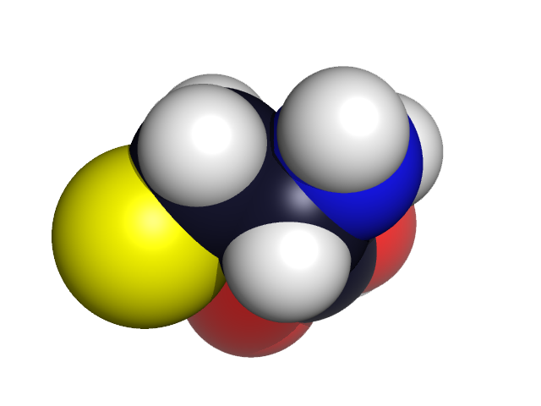
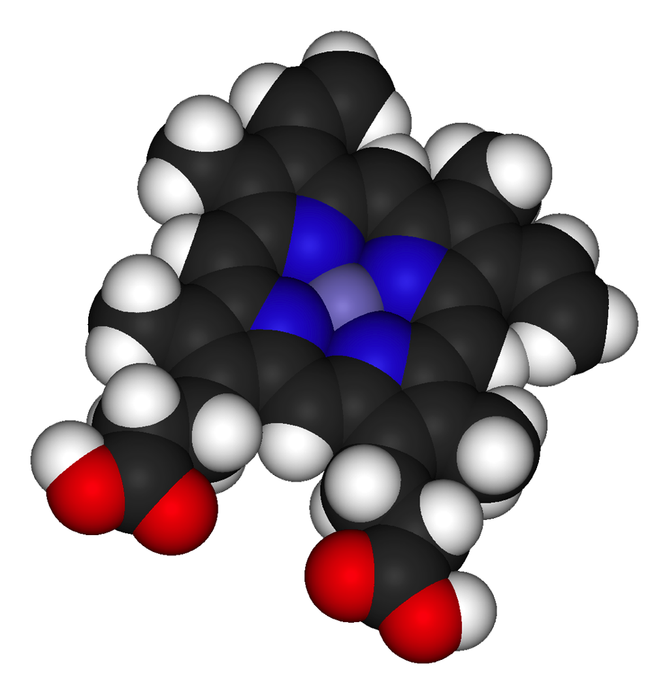
Steps Proposed in the
Origin of Life
The appearance of life on our planet may be understood as the result of evolutionary processes involving the following major steps:
➊
Formation of the Earth (4600 mya) and the
acquisition of volatile organic chemicals by
collision with comets and meteorites. These
provided the precursors of biochemical
molecules.
Prebiotic synthesis and accumulation of
amino acids, purines, pyrimidines, sugars,
lipids, and other organic molecules in the
primitive terrestrial environment.
Prebiotic condensation reactions involving
the synthesis of polymers of peptides
(proteins) and nucleic acids (most probably
just RNA) with self-replicating and catalytic
(enzymatic) abilities.
➋
Organic molecules
➌
Protein molecule

Slide 12
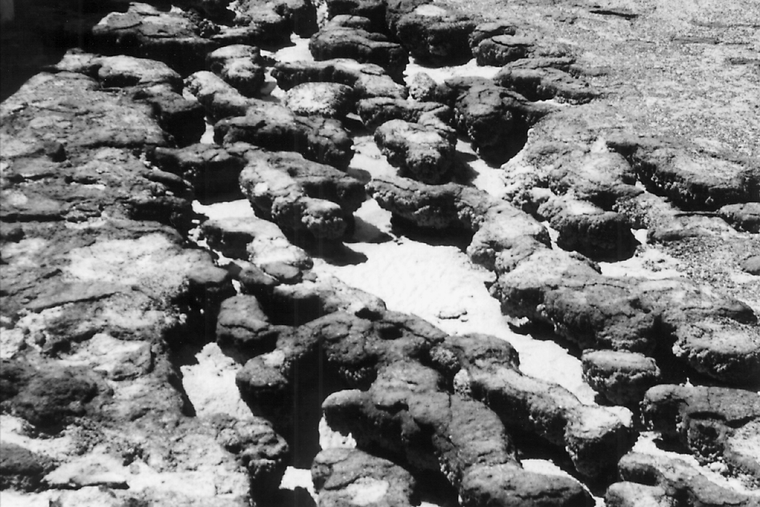
Steps Proposed in the
Origin of Life
4. Synthesis of lipids, their self-assembly
into double-layered membranes and
liposomes, and the ‘capture’ of self-
replicating, catalytic prebiotic molecules
within their boundaries.
5. Formation of a protobiont; an
immediate precursor to the first living
systems. Such protobionts would
exhibit cooperative interactions
between small catalytic peptides,
replicative molecules,proto-tRNA, and
protoribosomes.
Photo: Ron Lind
These living stromatolites from a beach in Western Australia are created by mats of bacteria. Similar, fossilized stromatolites have been found in rocks dating back to 3500 million years ago.

Slide 13

An RNA World
RNA molecules have the ability to act both as blueprint and as enzymes. This characteristic offers a way around the “chicken-and-egg” problem that:
  genes require enzymes to form;
  enzymes require genes to form.
The first stage in the evolution of life may have involved RNA molecules performing the catalytic activities necessary to assemble themselves from a nucleotide soup.
At the next stage, RNA molecules would begin to synthesize proteins. There is a problem with RNA as a prebiotic molecule because the ribose is unstable. This has led to the idea of a pre-RNA world (PNA).
Dynamics of an RNA world
RNA replication cycle
RNA forming
Polypeptide forming
Polypeptide acts as primitive enzyme that aids RNA replication
RNA acts as template for the creation of polypeptides
Polypeptide

Slide 14

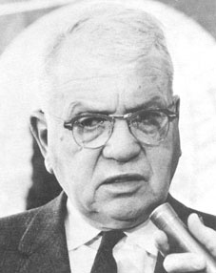
Prebiotic Experiments
In the 1950s, Stanley Miller (top right) and Harold Urey (bottom right) designed experiments to recreate the conditions of primitive Earth.
They aimed to create the biological molecules that were the forerunners to the development of the first living organisms.
At the time of the experiments, Earth’s early atmosphere was thought to be made up of methane, water vapor, ammonia, and hydrogen gas.
  The experiment produced amino acids, so it seemed that the building blocks of life are relatively easy to create.
  Many types of organic molecules have
  even been detected in deep space.
Stanley Miller
Photo: NASA
Harold Urey

Slide 15
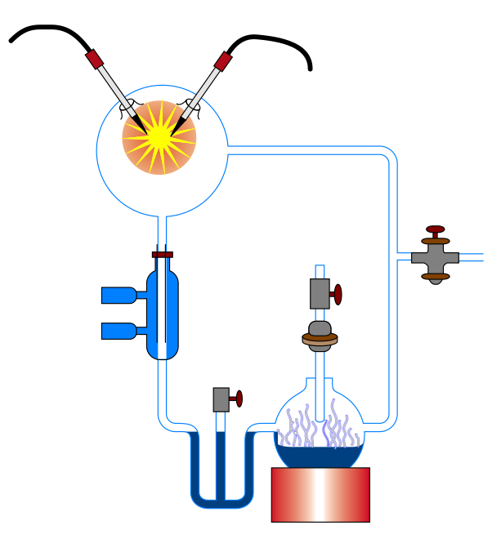
The Miller-Urey Experiment
Power supply provides 7500 volts at 30 amps to two tungsten electrodes.
Reaction chamber
A mixture of gases simulating the primordial atmosphere on Earth:
• Methane (CH₄)
• Ammonia (NH₃)
• Hydrogen (H₂)
• Steam (H₂O)
An electric discharge provides the energy to cause the gases to react.
The condenser cools the mixture of steam and gases, causing them to become liquid and trickle into the collection trap below.
Condenser
Vacuum pump used to expel air and introduce primordial gases.
Collection trap for extraction of a sample, which turned out to be rich in amino acids.
Heated flask: Water is boiled to simulate the primordial ocean (near a volcanic vent).
Heater

Slide 16
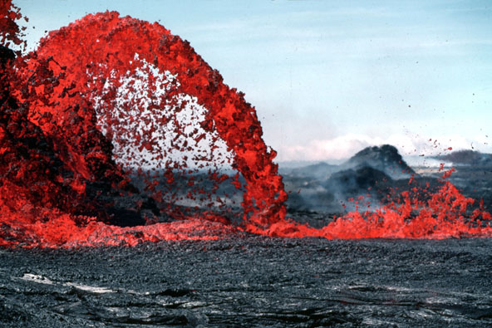
The Miller-Urey Experiment
The Miller-Urey experiment was run for a week. Samples from the collection trap (right) were analyzed.
  Up to 4% of the carbon (from the methane) had been converted to amino acids.
    In this and subsequent experiments, it has been possible to form all the 20 amino acids commonly found in organisms, along with nucleic acids, several sugars, lipids, adenine, and even ATP (if phosphate is added to the flask).
Photo: NASA
Photo: US Geological Survey
Researchers now believe that the early atmosphere may have been similar to the vapors given off by modern volcanoes (left). The gases include carbon monoxide (CO), carbon dioxide (CO2), and nitrogen (N2), but not free atmospheric oxygen.

Slide 17
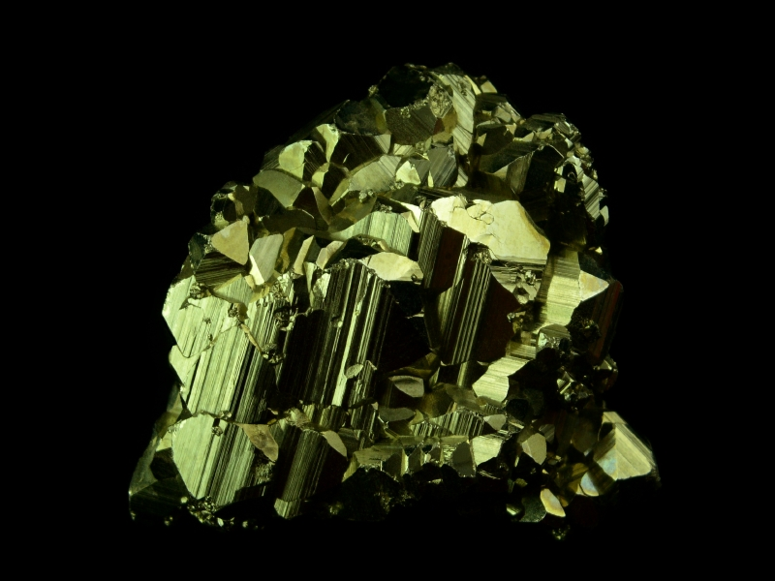
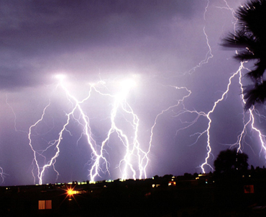
Conditions on
Prebiotic Earth
Conditions in some places on Earth today are similar to those of the prebiotic Earth.
Photo: iStock
Iron pyrite (fools gold) is a relatively common compound. It is often exposed to the environment during mining and excavation where it reacts with oxygen and water to form sulfuric acid. It has been proposed as a possible stabilizing surface for the synthesis of organic compounds in the prebiotic world.
Lightning is a natural phenomenon associated with volcanic activity. It may have supplied a source of electrical energy for the formation of new compounds (such as oxides of nitrogen) which were incorporated into organic molecules.

Slide 18
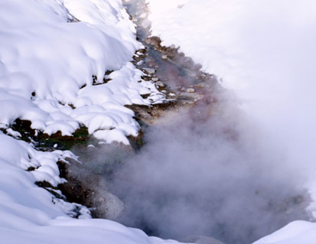
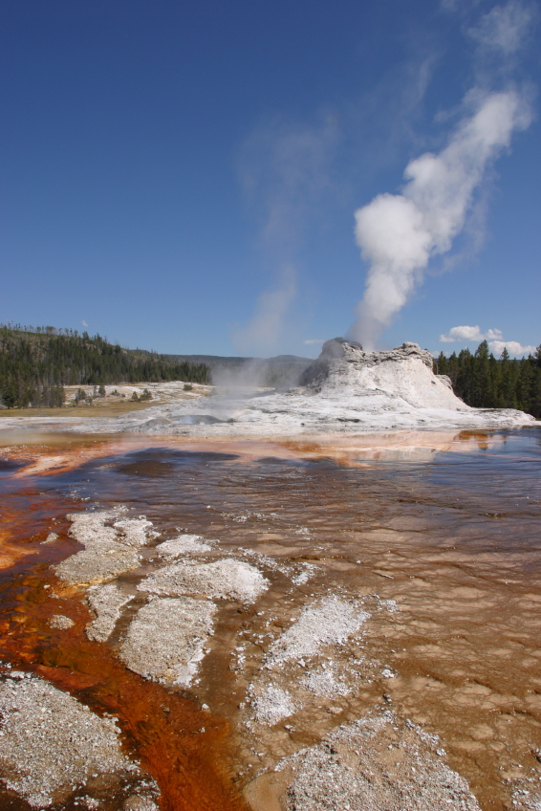
Conditions on
Prebiotic Earth
Some scientists envisage a global winter scenario for the formation of life. Organic compounds are more stable in colder temperatures and could combine in a lattice of ice. This frozen world could be thawed later.
Early Earth was subjected to widespread volcanism. At volcanic sites such as deep sea hydrothermal vents and geysers, gases delivered vital compounds to the surface, where reactions took place. These extreme environments still exist today (photo, right).
Photo: iStock

Slide 19
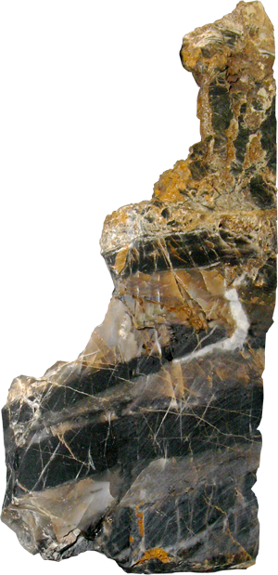
Early Life on Earth
The Earth formed 4.5 billion years ago (bya), and life developed soon after.
  Carbon isotopes belonging to a living organism have been found in Greenlandic rocks dated 3.9 bya.
  Stromatolite fossils dated 3.5 bya have been discovered in Australia.
Stromatolites form from the growth of photosynthetic cyanobacteria. As the numbers of cyanobacteria grew, the amount of oxygen in the atmosphere would have increased, until other forms of life, including eukaryotes could be sustained.
  Eukaryotic life appeared 1.9 bya.
The presence of ancient
fossilized stromatolites
(right) dated 3.5 bya,
proves that the Earth’s
environment contained
oxygen very early on.
The oxygen was
derived from the
photosynthetic
activity of
cyanobacteria.

Slide 20
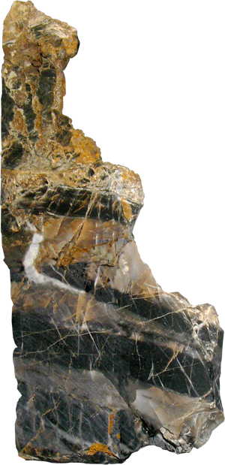
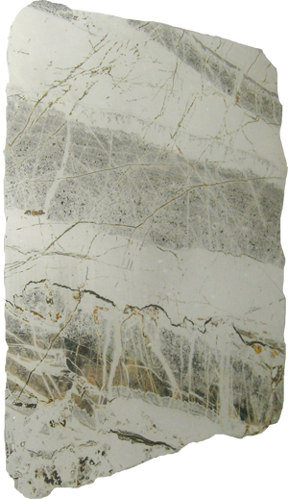
Early Life on Earth
A finely laminated stromatolite above layered black and white chert (3,500 million years old) from South Africa. Black lines indicate where a thin section was taken for examination.
Sawn slab from the stromatolite. Cyanobacterial fossils were removed
from this slab for microscopic examination.

Slide 21
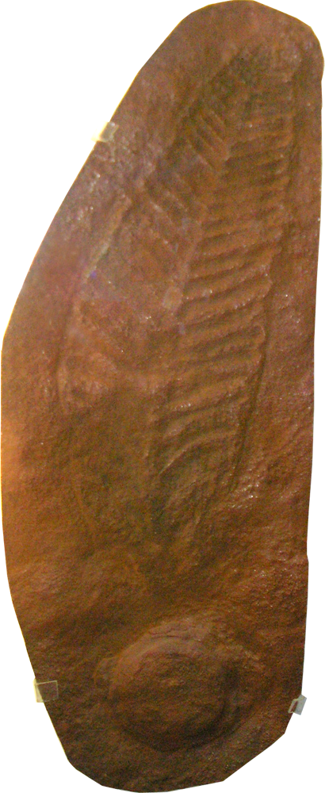
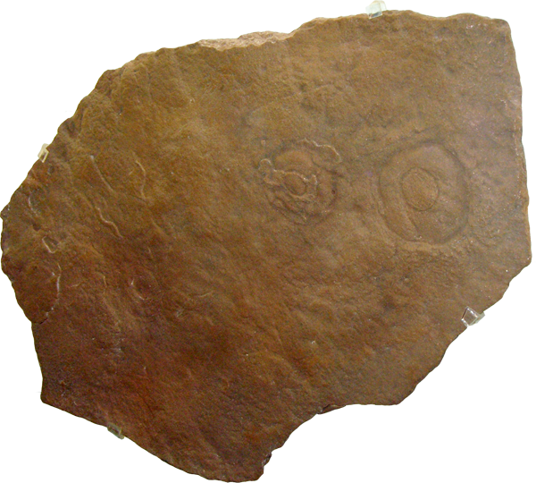
The Origin of Eukaryotes
Sea pen:
Charniodiscus
Eukaryotic cells first appeared
about 1.9 billion years ago.
It is thought that eukaryotic cells evolved from large prokaryotic cells that ingested other free-floating prokaryotes.
They formed a symbiotic relationship with the cells they engulfed. This is called endosymbiosis.
Evidence of multicellular organisms first appeared around 1.1 bya, with abundant multicellular fossils (e.g. the Ediacaran fauna) present by 0.55 bya.
Photographs taken by the author at the Albuquerque Museum
Jellyfish:
Medusinites
Precambrian fossils of multicellular organisms (~500 mya) include sea pens, jellyfish, and soft-bodied arthropod-like organisms.

Slide 22
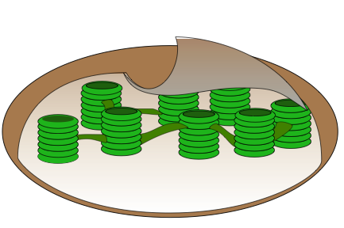
The Origin of Eukaryotic Cells
Chloroplasts have an internal membrane structure that is nearly identical to that of modern cyanobacteria.
The two most important organelles that developed in eukaryotic cells were:
    mitochondria, for aerobic respiration
    chloroplasts, for photosynthesis in aerobic conditions.
Primitive eukaryotes probably acquired mitochondria by engulfing purple bacteria.
Similarly, chloroplasts may have been acquired by engulfing primitive cyanobacteria, which were already capable of photosynthesis.
Chloroplast DNA (cpDNA)
Chloroplasts (above), possess a self-replicating circular chromosome. It uses a genetic code that contains prokaryotic features, supporting the probable origins of chloroplasts as endosymbionts.

Slide 23
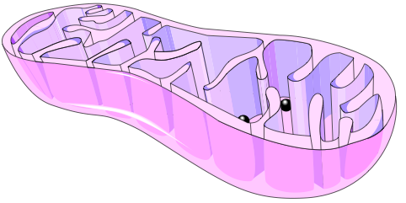
The Origin of Eukaryotic Cells
Mitochondrial DNA (mtDNA)
Mitochondria and chloroplasts would have become dependent on the nucleus of the host cell to direct some of their metabolic processes.
The lines leading to animal cells may have diverged before those leading to plant cells, but the reverse could also be true.
Animal cells might have evolved from plant-like cells that subsequently lost their chloroplasts.
Mitochondria possess a self-replicating circular chromosome and use a genetic code identical to that used by prokaryotes. This supports the probable origins of mitochondria as endosymbionts.

Slide 24



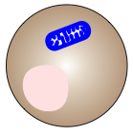



The Origin of Eukaryotic Cells
The sequence of evolutionary change suggests that the lines leading to animal cells diverged before those leading to plant cells, but the reverse could also be true.
Precursor prokaryotic cells
Aerobic bacterium
(pre-mitochondrion)
To present-day aerobic bacteria
To present-day animal cells
Both mitochondria and chloroplast retain DNA of their own
Nucleated
pre-prokaryote
pre-mitochondrion
engulfed
Mitochondrion
To present-day plant cells
A cell that could engulf others and which had packaged its own genes inside a nucleus
Nucleus
Photosynthetic prokaryote
(pre-chloroplast)
Pre-chloroplast
engulfed

Slide 25
Timeline
Geological column
Present
Fossil history of large eukaryotic organisms is well documented.
0.55 bya: Fossils of more complex, multicellular organisms were thought to have first appeared here (but see below). Fossils 600-540 my old, reaching 1m across have been found in the Ediacara Hills, Flinders Ranges, South Australia.
1.1 bya: Grooves in sandstone from the Vindhyan Basin, central India, may be the burrows of ancient worm-like creatures. This is 500 my earlier than any previous evidence for multicellular animals.
1.0
2.1 bya: First fossil imprints appear that are so large they can only be eukaryotes.
2.0
Billions of years ago (bya)
2.5 bya: Molecular fossil of cyanobacteria, 2-methylhopane, is abundant in organic-rich sedimentary rocks from the Mount McRae shale in Western Australia.
3.5 bya: The oldest microbial community now known is from the Apex chert of northwestern Western Australia; a diverse assemblage of fossil cyanobacterial colonies forming layered stromatolites.
3.0
2.7 bya: Compounds in the oily residue squeezed out of Australian shale suggest the presence of eukaryotic cells. It appears to push the beginnings of complex life on Earth a billion years earlier than first thought.
4.6 bya: Formation of the Earth.
Earth’s acquisition of volatile organic chemicals by collision with comets and meteorites provided the precursors of biochemical molecules.
4.0
A series of prebiotic steps that lead to the formation of the protobiont; an immediate precursor to the first living systems.
4.6

Slide 26
The Diversification of Life
A cladogram, based on 16S ribosomal RNA sequences, depicts the diversification of life from a last common ancestor. This “tree of life” is overwhelmingly composed of microscopic organisms.
The last common ancestor of all organisms
living today lies between the Archaea and
the Eubacteria.
EUKARYA
Eukaryotes
EUBACTERIA
Cyanobacteria
and bacteria
ARCHAEA
Archaebacteria
The eukarya are more closely related to the Archaea than to the Eubacteria
Last common ancestor

Slide 27
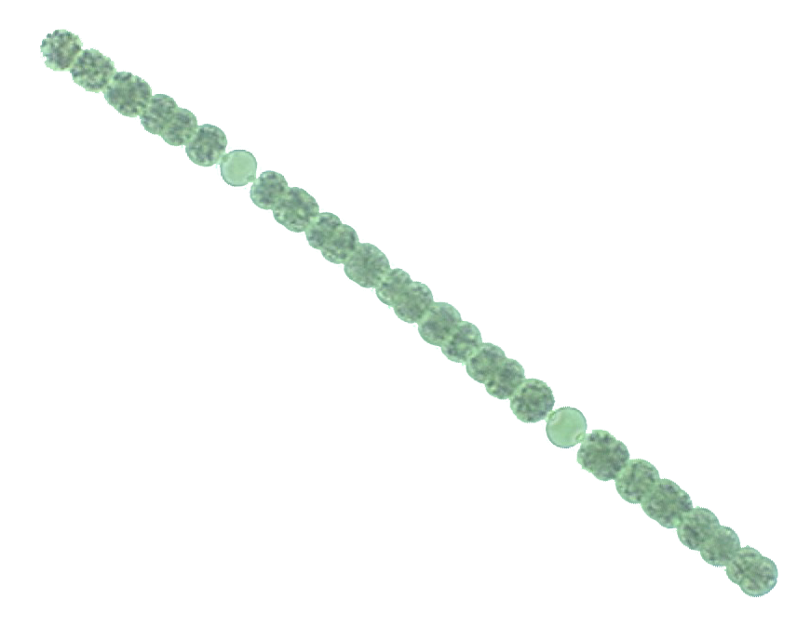
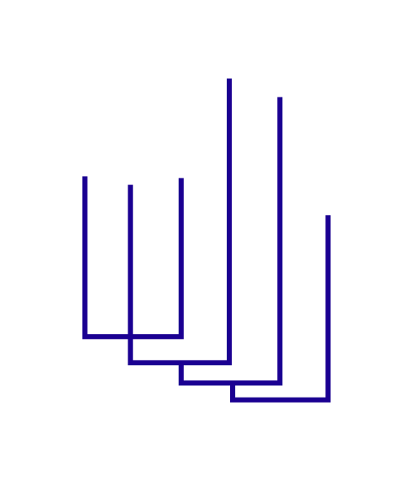
The Eubacteria
The Eubacteria includes the cyanobacteria and bacteria of traditional classifications. They are distinct metabolically and structurally from the Archaea.
Flavobacteria
Cyanobacteria
Green non-sulfur bacteria
Purple bacteria
Gram positive bacteria
Thermotogales
Anabaena; a modern representative of the cyanobacteria

Slide 28
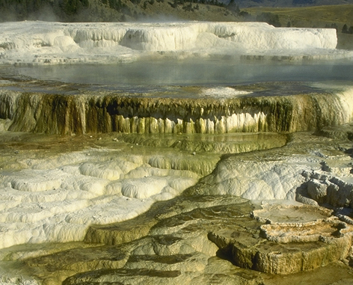
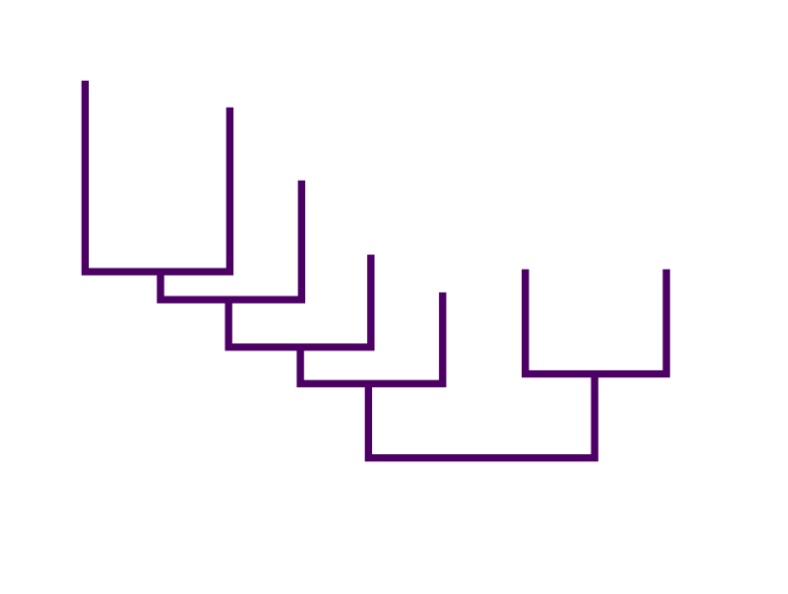
The Archaebacteria
The Archaea, or archaebacteria, includes methanogenic bacteria (anaerobic bacteria which produce methane) and many extremophiles (microbes that thrive in extremely acidic, high temperature environments).
Halophiles
Methano-sarcina
Methane bacteria
Methano-bacterium
Acidic hot springs:
the Archaean environment
Methano-coccus
Thermoproteus
T. celer
Pyrodictium
Extreme
thermophiles

Slide 29
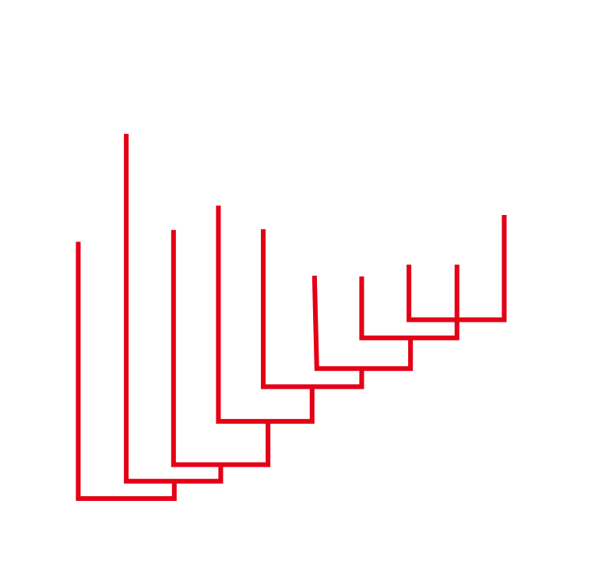
The Eukarya
The Eukarya, or eukaryotes, includes the plants, animals, and fungi as well as the lineages grouped together as protists under traditional classification schemes.
Protista (Protoctista)
Microsporidia
Flagellates
Tricho-monads
Ent-amoebae
Animals
Diplomonads
Ciliates
Slime molds
Plants
Fungi

Slide 30
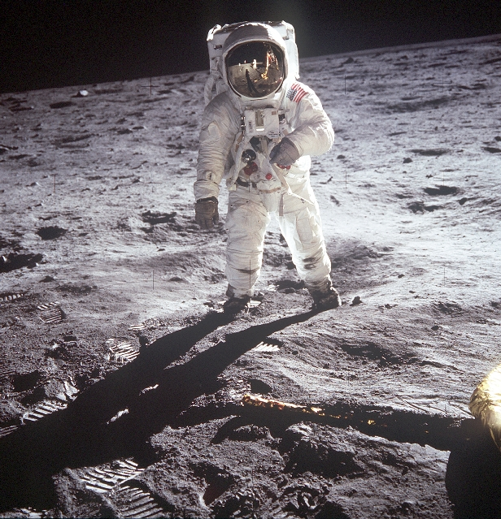
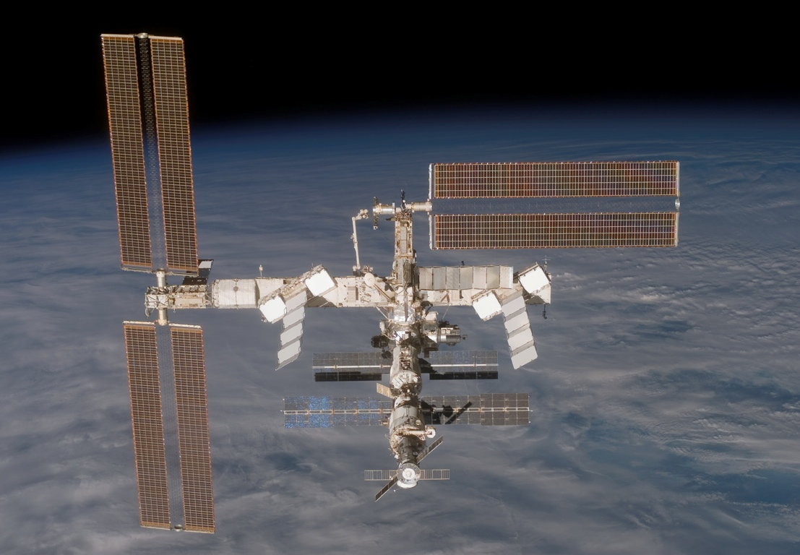
The Search for
Life off Earth
The study of the origin of life on Earth is closely linked to the search for life elsewhere in our solar system.
Many space exploration missions have been carried out to increase our knowledge of space, how life developed on Earth, and with the hopes of finding evidence of extraterrestrial life.
Photo: NASA
Astronaut Edwin E. Aldrin Jr walks on the surface of the moon during the 1969 Apollo 11 mission (top right). The International Space Station (right) is a manned research facility in orbit around the Earth. It is hoped that research will benefit medicine, materials, and fundamental science
Photo: NASA

Slide 31
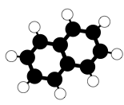
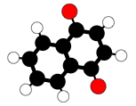

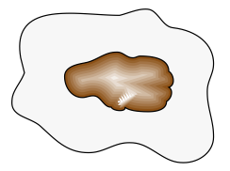




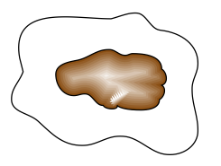
How Organic Molecules Might Form in Space
Methanol
Hydrocarbon rings
Water (ice)
Silicate granule (fragment of rock)
Ultraviolet radiation
The broken down molecules recombine into structures such as quinones, which would never form if the fragments were free to float away.
Carbon monoxide
Carbon dioxide
Interstellar ice begins to form when molecules such as methanol, water, and hydrocarbon freeze onto sand-like granules of silicate drifting in dense interstellar clouds.
Ultraviolet radiation from nearby stars cause some of the chemical bonds of the frozen compounds in the ice to break.

Slide 32
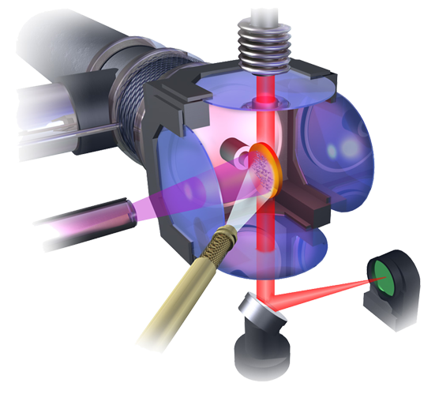
Cloud Chamber Experiments
Infrared lamp provides light source for analysis of the ice
Refrigerator
Salt disk acts as a silicate core for the ice grain
The formation of these organic molecules and their significance to the origin of life on Earth are currently being investigated experimentally using cloud-chamber experiments.
Cloud simulation chambers can be used to simulate carbon molecule formation in the cold parts of interstellar clouds.
Vacuum pump
Ice grains
Ultraviolet lamp provides radiation source
Infrared detector reveals the composition of the ice
Simple gas molecules are sprayed into the chamber
Source: Life’s far-flung raw materials, Scientific American, July 1999, pp. 26-33

Slide 33
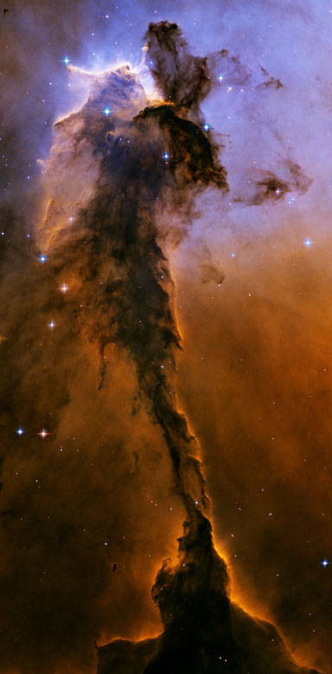
Cloud Chamber Experiments
Cloud-chamber experiments using simulated space ice (frozen water, methanol, and ammonia), produced complex compounds including ketones, nitriles, ethers, alcohols,
and quinones (nearly identical to those involved in the redox reactions of photosynthesis).
    These same organic molecules are found in carbon-rich meteorites.
A six-carbon molecule known as HMT (hexa-methylene-tetramine) was also created.
    In warm, acidic water HMT produces
    amino acids.
Photo: NASA and European Space Agency
The Eagle nebula (right) is the type of interstellar cloud formation that the cloud chamber experiments are trying to mimic.
Source: Life’s far-flung raw materials, Scientific American, July 1999, pp. 26-33

Slide 34
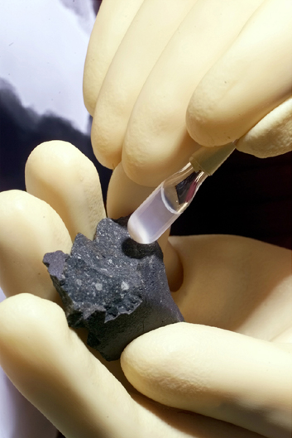
Cloud Chamber Experiments
Another cloud chamber investigation showed that some of the molecules aggregated to form capsule-like droplets in water.
The capsules were similar to capsules produced from experiments using extracts from the Murchison meteorite.
    When organic compounds from the Murchison meteorite were mixed with water, they spontaneously assembled into spherical structures similar to cell membranes.
    These capsules were found to be made up of a host of complex organic molecules.
Photo: Argonne National Laboratory, USDOE
This meteorite fragment is from the Murchison meteorite, so named because it fell near the town of Murchison (Victoria, Australia) in 1969.
Source: Life’s far-flung raw materials, Scientific American, July 1999, pp. 26-33

Slide 35

Organic Molecules in Space
130 organic molecules have been found in space, or meteorites.
Organic molecules in space are identified using infrared spectroscopy. Each molecule has its own unique vibrational frequency, allowing for identification.
Key groups of molecules identified are:
  Amino acids, e.g. glycine, serine and alanine, which form proteins
  Hydrocarbons, e.g. anthracene, acetamide, which can be modified to form a huge array of carbon molecules.
  Glycolaldehyde and ethylene glycol for formation of sugar molecules.
Photo: NASA
The hydrocarbons anthracene and pyrene were discovered in the Red Rectangle Nebula.

Slide 36

Life on Mars?
The possibility of finding life on Mars has long been speculated.
    It has several similarities to Earth, including the presence of polar ice caps, seasonality, and an atmosphere.
    Mars is also in close proximity to Earth.
Photo: NASA and The Hubble Heritage Team
Mars has a red appearance because of the presence of iron(III) oxide (rust) at its surface. This image was captured by the Hubble telescope.

Slide 37



The Viking Mission
In 1976, two spacecraft were sent to Mars by the National Aeronautics and Space Administration (NASA).
  The Mission was known as the Viking Mission.
  Two landing craft touched down on Mars. Their purpose was to:
    gather images and scientific data about the Martian planet.
    conduct biological experiments to determine if Mars has ever sustained life.
Photo: NASA
Photo: NASA
The Viking orbiter (top) and images of the Martian landscape taken from the Viking 2 lander vehicle.

Slide 38




The Viking
Experiments
The Viking landers collected samples of Martian soil using flexible robotic arms (top right).
Three biological experiments were carried out to determine if any biological life was present on Mars.
For each experiment a control sample was heat sterilized to destroy any living material that
may have been in the soil.
  If the control returned a
  positive result, the test results could be discounted as the result of a non-biological process.
Photo: NASA
❶
❷
Pyrolytic release experiment
Gas exchange experiment
❸
Labeled release experiment

Slide 39

Gas Exchange Experiment
The gas exchange experiment was designed to detect biological activity by monitoring changes in gas composition within a chamber.
  Changes would indicate active metabolism; gases being metabolized and released as a result of metabolic activity.
Oxygen was produced in both the test and control samples, so it was concluded that this experiment indicated no evidence of biological life.
  Subsequent work on Earth has shown that the presence of oxidizing compounds (oxides and superoxides), produced the oxygen, not life forms.
Nutrient medium and gases
The moisture levels in the experimental chamber were varied to contain no, mid, and high levels of water.
Martian soil
Gas chromatography column
Gas detector for H2, N2, O2, CH4, CO2

Slide 40
Pyrolytic Release Experiment
This carbon assimilation experiment aimed to determine if photosynthetic organisms were present on Mars.
Soil was incubated with radioactively labeled CO2 and CO, then pyrolyzed to break down any organic material.
A C¹⁴ detector was used to measure radioactive material in the soil and determine if any organisms had converted the labeled carbon gas into biomass.
  The test sample and control samples both showed low levels of carbon assimilation. This false-positive result indicated a non-biological process caused the carbon assimilation.
Labeled carbon
Light source
(xenon arc lamp)
Martian soil
Organic trapping column
Pyrolysis heater
C¹⁴ detector

Slide 41
Labeled Release Experiment
Labeled nutrient solution
This experiment was designed to detect the carbon dioxide produced from the metabolic activity of microorganisms.
Soil was incubated with nutrients containing radioactively labeled carbon. If life was present, labeled gaseous products would be produced as metabolic products.
Labeled gas was produced in the test sample only. This positive result suggested the presence of life on Mars.
  This validity of this result is still debated. Some believe that experimental flaws are responsible for the outcome, while others contest it is evidence for life on Mars.
Martian soil
C¹⁴ detector

Slide 42
Predicted Results for
Life on Mars
The table below summarizes the expected results if the Viking experiments had found evidence for life on Mars. In this scenario the test sample would record a positive result and the control sample would have had a negative (nil) response.
Experiment | Sample result | Control result
Gas exchange | O2 or CO2 detected | No O2 or CO2 detected
Labeled release | Labeled gas detected | No labeled gas detected
Pyrolytic release | Carbon detected | No carbon detected

Slide 43
Predicted Results for
No Life on Mars
The table below summarizes the expected results if the Viking experiments had found no evidence for life on Mars. In this scenario both the test sample and control sample would produce a negative (nil) response.
Experiment | Sample result | Control result
Gas exchange | No O2 or CO2 detected | No O2 or CO2 detected
Labeled release | No labeled gas detected | No labeled gas detected
Pyrolytic release | No carbon detected | No carbon detected

Slide 44
Actual Viking Results
The actual experimental results for the Viking experiments are displayed in a highly simplified form in the table below.
Experiment | Sample result | Control result
Gas exchange | O2 detected | O2 detected
Labeled release | Labeled gas detected | No labeled gas detected
Pyrolytic release | Carbon detected | Carbon detected
Only the labeled release experiment met the criteria for the detection of life on Mars; the test sample produced a positive result and the control sample produced a negative result. Non-biological processes were responsible for the false-positive results in the remaining experiments.

Slide 45

The Results
The results from the Viking experiments are still debated today.
  Many still think Mars cannot sustain biological life, while others argue the Viking experiments showed life to be present. Still others believe that the experiments were flawed and therefore meaningless.
    The Viking experiments sampled surface soil. One hypothesis is that as conditions on Mars worsened, organisms may have moved deeper into the soil where they would be protected from the harsh environment.
    Subsequent to the Viking experiments, many other compounds, not tested for at the time, have been found to sustain life.
Photo; NASA

Slide 46

Recent Mars
Findings
The detection of microbes in extreme environments on Earth, e.g. hydrothermal vents, has shown that many substances, including hydrogen, methane, sulfur, and iron can sustain biological activity.
  The Viking landers may not have detected life because they were not looking for all the signs of the life we know of today.
Photo: US NAOO

Slide 47


Recent Findings on Mars
In 1996 NASA scientists announced that a Martian meteorite, ALH84001, found in Antarctica contained bacteria like forms and organic material.
  Today, many scientists believe
  that the microfossils and organic material resulted from earthly contamination and are not evidence for life on Mars.
Isotope analysis of the Tagish Lake meteroite from Canada in 2006 has shown that the carbon bubbles present in it did not form on Earth.
  The molecules present may have provided the basis for the formation of life off Earth.
Photos: NASA
A SEM of a fragment of the Allan Hills meteorite ALH84001 from Antartica, showing what was believed at the time to be bacterial microfossils.
Notes:
Allan Hills meteorite (ALH84001) found in Antarctica in 1984.
Probably impacted with Earth 13,000 years ago.
Tagish Lake (Canada) meteorite impacted with Earth 18 January 2000.

Slide 48

Water on Mars
August 1999
The topography of Mars suggests that it once contained surface water, and so may have sustained life.
Recent photos from the Mars global surveyor showed the presence of liquid water on the surface of Mars.
  Images clearly showed new gullies which had formed from liquid water flow over the last seven years.
  The liquid water may sustain biological life on Mars.
September 2005
New deposit
Photo: NASA

Slide 49

Further Space Exploration
There are further plans to send solar and lunar orbiters to other planets and their moons, and even to land on a comet in November 2014.
Their objective will be to look for signs of life (present or past) or its chemical precursors.
If detected, such a discovery would suggest that life (at least ‘primitive’ life) may be widespread in the universe.
Photo: NASA
Construction of solar arrays for the Phoenix Mars lander project, set for launch in 2007. The probe will land at the Northern ice cap and gather information about the Martian environment.

Slide 50

Water on Saturn’s Moons
In March 2006, cold water geysers were discovered on the Saturn moon, Enceladus.
  The geysers contain a raft of organic molecules including methane, propane and carbon dioxide.
  If hydrothermal vents are also present (as suspected), then Enceladus has the three key ingredients required to sustain life as we know it.
Enceladus is now a key contender in the search for life off Earth.
Photo: NASA
This image of Saturn was taken from cameras on board the Cassini spacecraft. Saturn has 47 moons.

Slide 51

Life on Titan?
Titan is the largest moon of Saturn, and the only moon in our Solar System with a dense atmosphere, 10 times thicker than the Earth’s.
The atmosphere on Titan is similar to that of the early Earth when life began; approximately 95% nitrogen with traces of methane and ethane.
The smog-like haze surrounding Titan could conceal carbon-rich lakes, oceans, and storms of gasoline-like chemical rain.
Could it also house life?
Image: NASA
The organic nature of some of the chemicals found in Titan's atmosphere might indicate that this fascinating moon could harbor some form of life.

Slide 52


Life on Titan?
Photo: ESA
Photo: NASA/JPL/USGS
This image of Titan’s rocky surface was captured by the Huygens probe in 2005. There is evidence of erosion indicating possible surface fluvial (river) activity.
This radar image of Titan’s surface was captured by the Cassini spacecraft in 2006. Liquid methane lakes (dark colored) are scattered throughout Titan’s surface.

Slide 53

Pioneer 10 Probe
The Pioneer 10 probe was launched in 1972.
Its original mission was to photograph Jupiter and its satellites, and gather information along the way.
Pioneer 10 transmitted information for 30 years, far exceeding its original 21 month mission.
The signal with Pioneer 10 was lost in 2003.
  The probe is heading towards the red star Aldebaran. It will take more than 2 million years to reach Aldebaran.
Photo: NASA
The Pioneer 10 probe (above) was the first spacecraft to travel through the asteroid belt to the outer solar system.

Slide 54


Pioneer 10 Probe
Pioneer 10 was fitted with a pair of aluminum plaques to communicate with extraterrestrial life, in the event of discovery.
In addition to nude male and female symbols, the plaques provided information about the probes origins.
Representation of a hydrogen molecule.
Silhouette of Pioneer 10.
Binary equivalent of decimal 8.
Image: NASA
Position of the Sun.
Pioneer 10 trajectory.
Diagram of the solar system. The relative distances are given in binary.

Slide 55


SETI
Photo: iStock
SETI (Search for Extraterrestrial Intelligence), is a group comprising government organizations, companies, and research institutes looking for evidence of intelligent life in the universe.
The skies are scanned for radio pulses and light beams which may have been sent by other intelligent life forms.
SETI run many other programs to help decode the mystery of life in the universe. These include:
  Studies into the origin of life on Earth.
  The feasibility of life on Mars.
  Development of new technologies for improved signal searching.
SETI is NOT involved with any research into:
• Alien abductions
• UFOs
• “Events” at Roswell
• “Events” at “Area 51”

Slide 56


Slide 57
Terms of Use
Biozone International retains copyright to the intellectual property included in this presentation file, with acknowledgement that certain photos are used under license and are credited appropriately on the next screen.
You MAY:
  Use these slides for presentations in your classrooms using a data projector, interactive whiteboard, and overhead projector.
  Place these files on the school’s intranet (school computer network), but not in contradiction of clause 3 (a) below.
  Edit and customize this file by adding, deleting, and modifying information to better suit your needs.
  Place these presentation files on any computer within the school, including staff laptops.
  Print out this file in PowerPoint “Handouts” format as per the print dialogue box, for the express purpose of allowing students to make their own notes about the presentation.
You MAY NOT:
  Put these presentation files onto the internet or on a service that may be accessed offsite from the campus, unless access to the service is protected by a user login and password protocol.
  Print these files onto paper to make your own worksheets for distribution to students.
  Create a NEW document using any of the graphics/images in this presentation file.
  Incorporate any part of this presentation file for the production of another commercial product.
  REMOVE any of the references to Biozone, the copyright notices, photo credits, or terms of use from this file.

Slide 58
Photo Credits
Photographic images are used under licence from the following photo libraries:
  iStockPhotos.com
  PhotoObjects.com
  NASA/JPL/ESA
Some additional artwork and photographs are the property of Biozone International Ltd.
BIOZONE International Ltd | P.O. Box 13-034, 109 Cambridge Road, Hamilton, NEW ZEALAND
Phone: + 64 7 856-8104 | Fax: + 64 7 856-9243 | E-mail: sales@biozone.co.nz | Internet: www.biozone.co.nz
Copyright © 2007 Biozone International Ltd
All rights reserved

Slide 59







Presentation MEDIA
See our other titles:
See full details on our web site:
www.thebiozone.com/media.html

